Slide 1
Ra
Toolbar strip – New, Open, Export, Save, About, Exit?
Existing Character List
(listbox?)
Realm/Race/Class
Level, Spec points, bonus stats, autotrain T/F, level bookmark selection
Stats
(grow with level)
Spec lines
(This would include the class abilities)

Slide 2
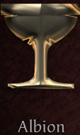


Community member’s picture of moused over class with character’s name and level
FUTURE?
Alb Classes
Hib Classes
Mid Classes
Class Description
NEW CHARACTER SCREEN
Create
Cancel

